Slide 1
Josep Mª Castellví luca saccoccia Diego Alonso Rocio bueno
2025 Bike Availability Prediction
(Summer Edition)

Slide 2
AGENDA
Kaggle challenge
Analysis
Conclusions & Study Limitations

Slide 3
Kaggle challenge

Slide 4
dESCRIPTION
Data prep → focus on 2023-2024
Bike’s usage started to stabilize in 2023(Cortez-Ordoñez, Alexandra, and Ana Belén Tulcanaza-Prieto. 2024.)
Models’ try-out
Linear regression
Gradient boosting regressor
Random forest
Neuronal network LSTM
Prediction

Slide 5
Why we DISCARDED before 2023?
Covid-19
Unusual Mobility Patterns Due to COVID-19
Government-Imposed Restrictions
Return to office policy
Non-Representative User Behavior
Risk of Bias in the Model (Data Anomalies and Outliers)
Focus on Post-Pandemic Trends
New city occupancy
Cortez-Ordoñez, Alexandra, and Ana Belén Tulcanaza-Prieto. 2024. "Are We Back to Normal? A Bike Sharing Systems Mobility Analysis in the Post-COVID-19 Era" Sustainability 16, no. 14: 6209. https://doi.org/10.3390/su16146209

Slide 6
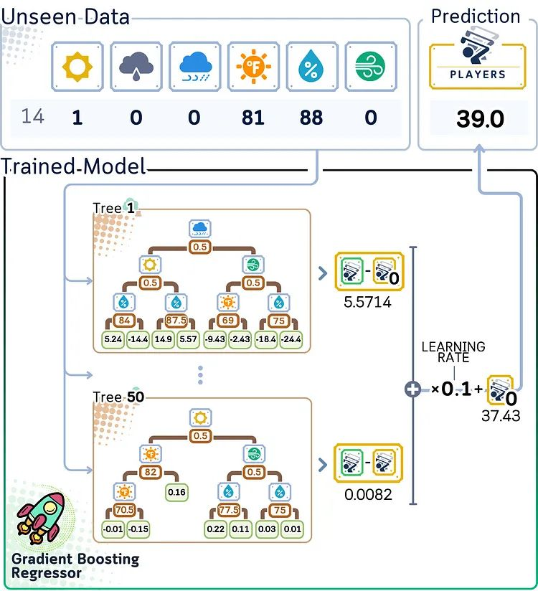
Here’s how Gradient Boosting works:
Initialize Model: Start with a simple prediction, typically the mean of target values.
Iterative Learning: For a set number of iterations, compute the residuals, train a decision tree to predict these residuals, and add the new tree’s predictions (scaled by the learning rate) to the running total.
Build Trees on Residuals: Each new tree focuses on the remaining errors from all previous iterations.
Final Prediction: Sum up all tree contributions (scaled by the learning rate) and the initial prediction.
A Gradient Boosting Regressor starts with an average prediction and improves it through multiple trees, each one fixing the previous trees’ mistakes in small steps, until reaching the final prediction.
https://medium.com/data-science/gradient-boosting-regressor-explained-a-visual-guide-with-code-examples-c098d1ae425c

Slide 7
ANALYSIS

Slide 8
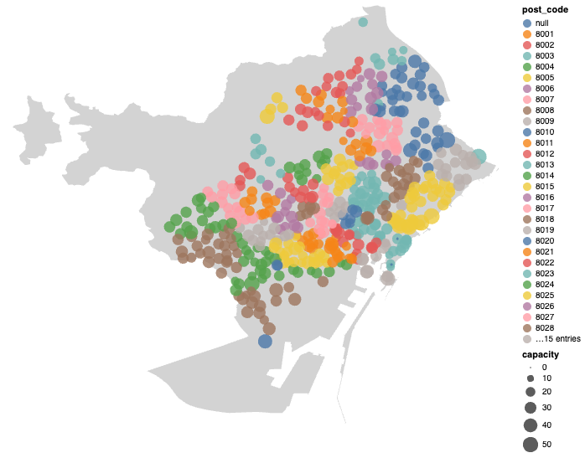
POSTAL CODES
Touristic, commerce and high-income districts (Eixample, Ciutat Vella) present larger stations with higher usage→ commuting and leisure activities.
High-capacity stations in business-heavy postal codes reflects weekday commuter traffic ie. 22@, downtown BCN.
Smallest stations in upper BCN reflects lower demand (lower population density, less commercial activity)

Slide 9
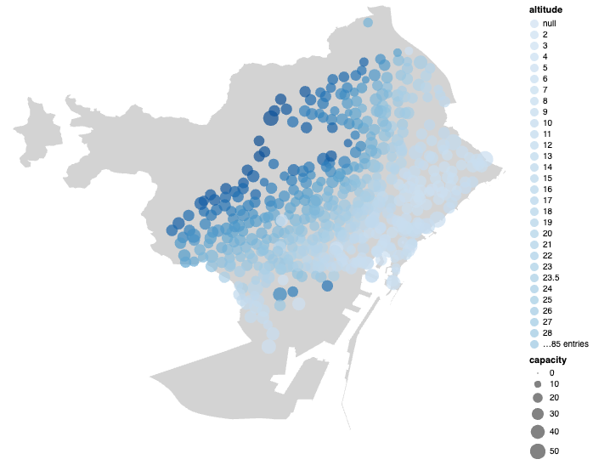
altitude
Deeper to light blue showing average availability affected by Barcelona altitude
Low altitude = low availability

Slide 10
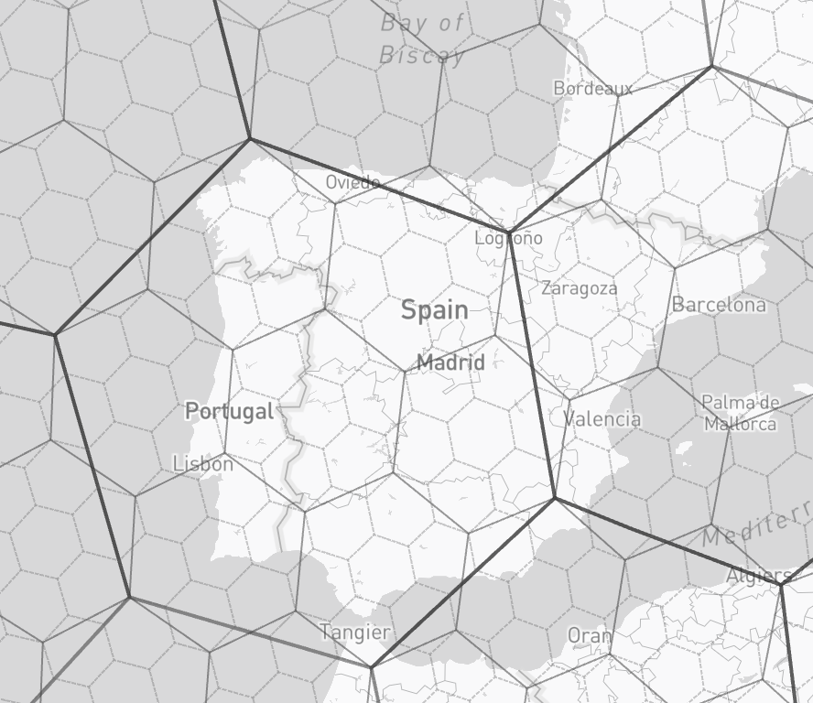
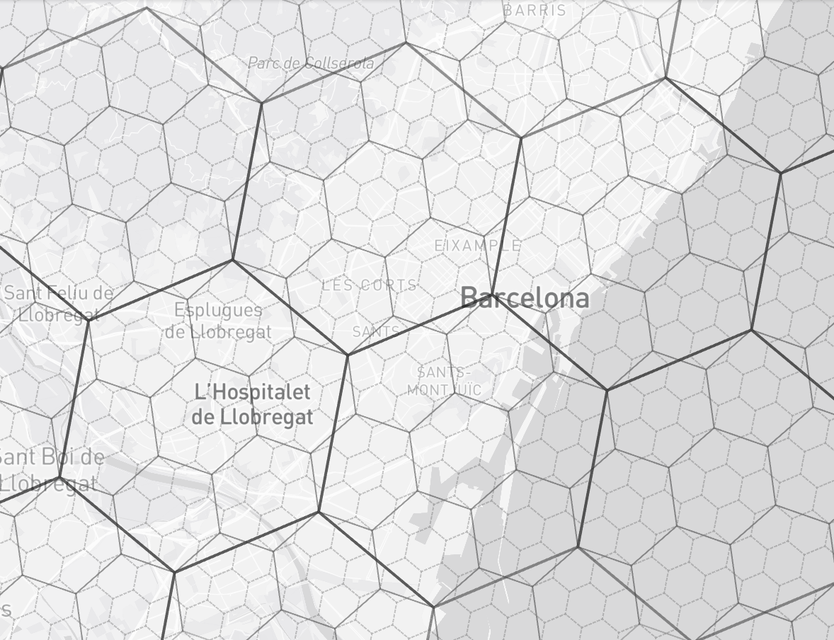
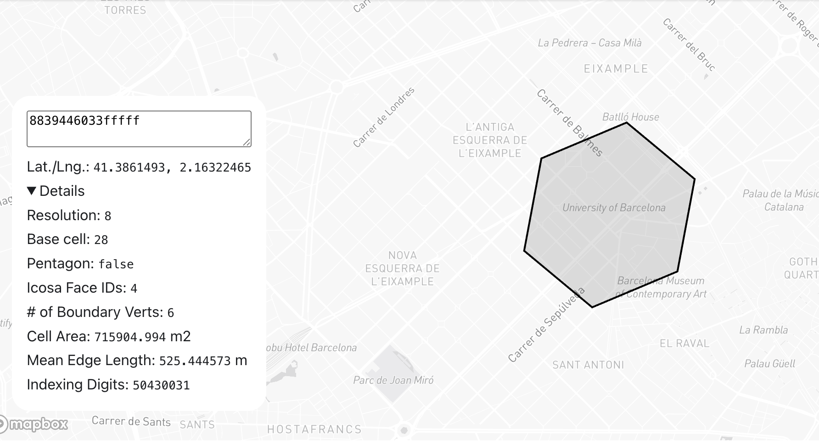
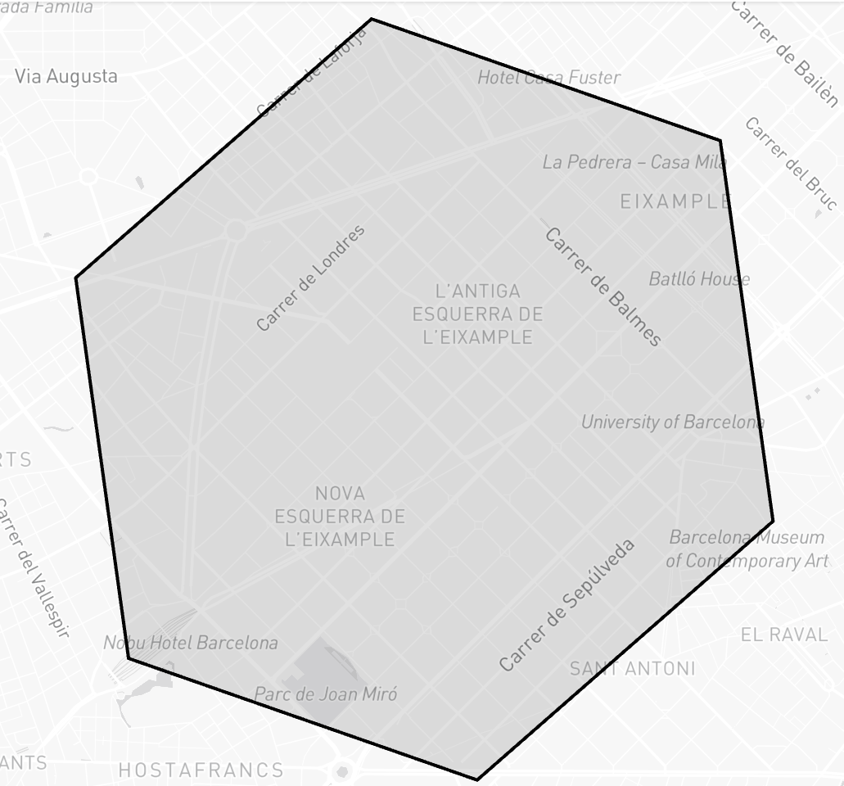
H3GEO.org

Slide 11
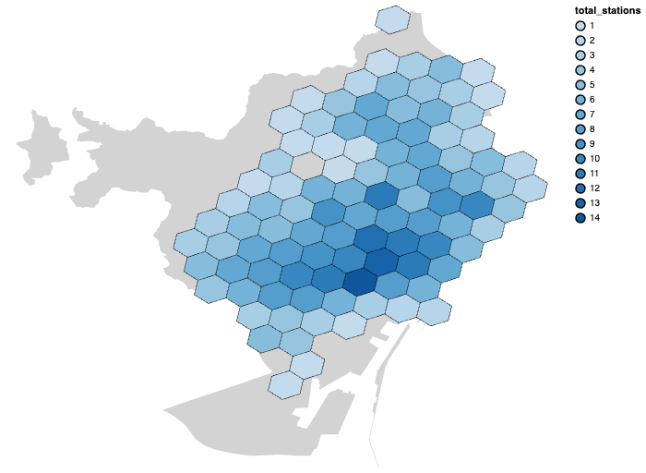

TOTAL BICING STATIONS
High-Density Clusters (darker hexagons):
Central neighborhoods (Eixample, Ciutat Vella, or Gràcia).
Areas with high population density, commercial activity, or public transport hubs (more integrated into daily mobility).
Low-Density Zones (lighter hexagons):
Residential areas with fewer stations.
Zones with lower Bicing adoption, possibly due to topographical challenges (see altitude), different mobility needs (car/motorbike usage)

Slide 12
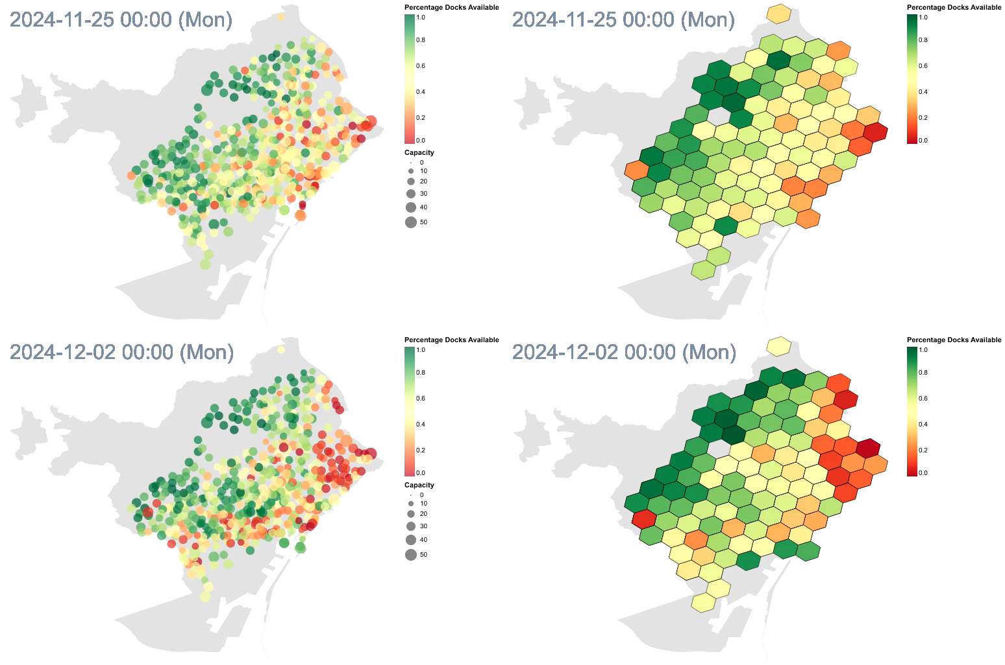
Let’s take a look at this video!

Slide 13
WEEKDAYS
TIME OF DAY PATTERNS
NEIGHBORHOOD INSIGHTS
WEEKDAY
Early Morning (1–4 AM):
High dock availability in central areas
Low activity in residential zones
Morning Rush (6–9 AM):
Dock shortages in outer residential neighborhoods → inbound commuting.
Midday (1–2 PM):
Balanced availability across most zones.
Slight shortages near universities and commercial hubs.
Afternoon Peak (5–6 PM):
Bikes move toward residential areas.
Central and coastal zones show moderate availability.
Evening (9–10 PM):
Bikes return to outer residential neighborhoods. Central stations begin to refill
Ciutat Vella & Eixample:
Act as bike dropping points during the day and bike source at night.
High turnover due to tourism, offices, and retail.
Gràcia, Sant Martí, Sants-Montjuïc:
Morning bike departures and evening dock congestion → Strong commuter behavior.
Les Corts & Sarrià-Sant Gervasi:
Lower usage→ maybe due to higher car ownership + fewer Bicing stations.
Poblenou & Glòries:
Midday and afternoon peaks, perhaps due to tech offices and shopping centers.
Monday to Wednesday
Consistent commuter patterns. Slightly increasing in Wednesday’s midday.
Thursday
Evening usage increases, especially near leisure zones.
Friday
Morning and midday similar to weekdays.
Evenings show higher returns to residential areas → weekend transition.

Slide 14
WEEKENDS
TIME OF DAY PATTERNS
NEIBORHOOD INSIGHTS
WEEKDAY GRAL
Early Morning (6-7 AM):
High dock availability in residential zones
Midday (1–2 PM):
Increased usage in coastal and tourist zones (Barceloneta, Ciutat Vella).
Evening (9–10 PM):
Return flow to residential neighborhoods (e.g., Sant Martí, Les Corts).
Docks in nightlife zones (El Raval, Gothic Quarter) show low availability, suggesting bikes are being dropped off there.
High availability zones:
Les Corts & Sarrià-Sant Gervasi:
Consistently green across all time slots.
Low Bicing usage—>higher car ownership or less dense station coverage.
Diagonal Mar - Forum:
High availability in mornings, moderate in evenings → recreational use patterns.
Low availability zones:
Ciutat Vella:
Red zones during midday and evening.
High tourist and leisure activity; stations often emptied by users arriving.
Eixample:
Mixed patterns; central hubs show high turnover.
Weekend usage
Is more leisure oriented with peak demand in tourist and coastal areas.
Peripheral areas
Rely more on cars, while downtown shows bigger bicing adoption

Slide 15
CONCLUSIONS

Slide 16
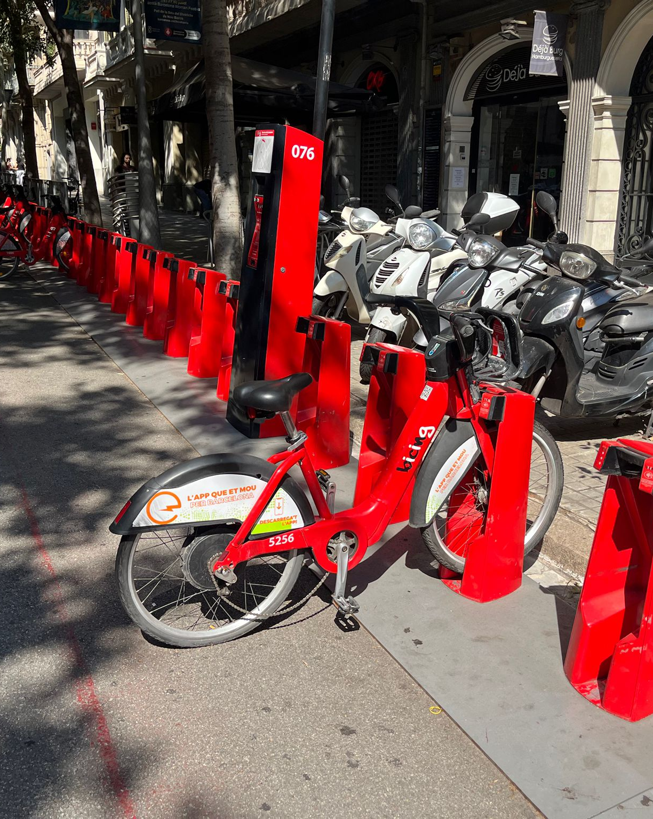
CONCLUSIONS
Central and costal neighborhoods slow dock availability
Upper Barcelona higher dock availability (slower usage and different mobility trends)
Station capacity and density in highest-central / high income areas
Spatial clustering around transit and commercial hubs (i.e. Glories)
Peripheral areas have fewer and smaller stations

Slide 17
THANK YOU

